Slide 1

Smart Traffic Fine Generation System
Presented by:- Guides:-
Dhruvkumar Patel (15CP049) [1] Dr. N.M Patel
Ketan Bhalerao (15CP050) [2] Prof. P.B Swadas
Monil Shah (15CP051)

Slide 2
Introduction
These days traffic is increasing at an alarming rate. This leads to uncontrollable traffic at crossroads. Moreover, certain rules have been incorporated by RTO which are necessary for maintaining public discipline.
However, a very practical fact proves that people these days hardly obey the incorporated rules which may result in severe accidents as well as society indiscipline.
This project aims to tackle these problems via a fully automated system which will track the moving vehicles on road and if a particular vehicle breaks a rule of surpassing crossroads while red light is on, the same vehicle’ s identity will be extracted through machine learning algorithms.
Later, after the identity of vehicle has been determined, an automated fine deduction will take place from vehicle owner’s account of which the user will be Mailed or texted.

Slide 3
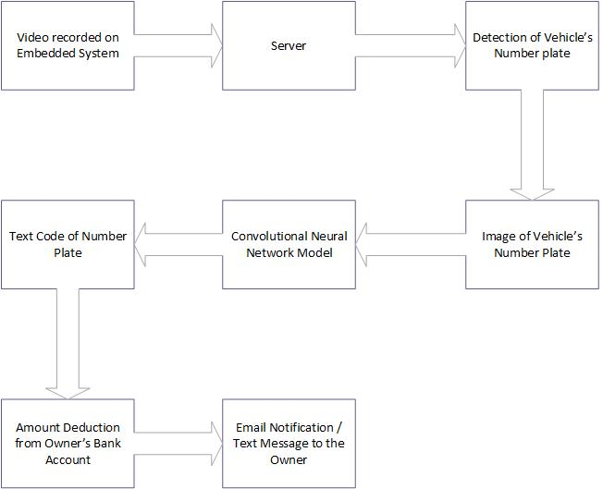
Project Flow

Slide 4
Project Outline
Record the video of moving vehicles
Send the video to server through IOT
Separate the frames of received video
Remove the duplicate frames
Apply object detection algorithm for getting vehicle’s number plate
Apply CNN on number plate
Match the vehicle’s number in database
Send an email to owner of vehicle

Slide 5
Project Modules
Real time video transmission module
Video processing module
Number Plate Detection Module
Number Recognition Module
Fine Generation Module
Email Generation Module

Slide 6
Technologies to be utilized
Python 2.7
CNN Modules: Tensorflow and Keras
YOLO (for Object Detection)
MySQL Database
Flask/Django Server for Receiving Videos
Image Processing libraries: OpenCV and PIL
Transfer Learning Model: Inception V3

Slide 7
Work done till now…
Number Plate Detection Using the logic of edge detection.
CNN trained using MNIST dataset (achieving 89% Accuracy)
Database normalized schema made ready in MySQL.
Prepared a GUI for displaying results.
Prepared a dataset of number plates and their respective co-ordinates

Slide 8
Our current targets
Train YOLO over our self prepared dataset.
Train a transfer learning model for recognizing Number on the number plate.
Prepare a real time video transmission system.
Prepare automatic Notification generation code for informing the vehicle’s owner.

Slide 9
Project Applications
It is can used be to maintain discipline among public there by decreasing the risk of traffic accidents.
Man labor will be reduced thus leading to reliable system.
Digitization in traffic controlling system will prove as a push to digital India mission.
Transparency in fine collection will be improved.

Slide 10
Thank You!

